Slide 1

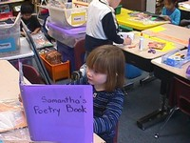
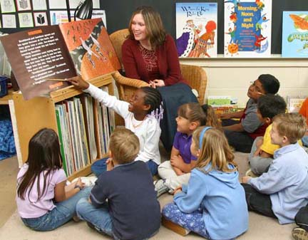
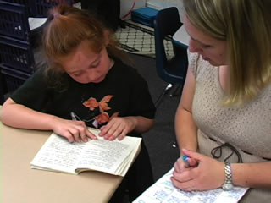
Growing Readers at
Goosehill Primary School
Parents and Teachers
Working Together

Slide 2
What are some of the essential skills and behaviors our children need to develop as readers?
Phonemic awareness
Letter-sound knowledge
Fluency
Comprehension Strategies
Vocabulary and background knowledge
Positive reading habits

Slide 3
Phonemic Awareness
the ability to hear and manipulate the sounds in spoken words
essential to learning to read because letters represent sounds (phonemes). Without phonemic awareness, phonics doesn’t make sense.
If a child cannot hear that "man" and "moon" begin with the same sound or cannot blend the sounds /rrrrrruuuuuunnnnn/ into the word "run", he or she may have great difficulty connecting sounds with letters or blending sounds to make a word.
a strong predictor of early reading success.

Slide 4
What parents can do to support the development of phonemic awareness and letter-sound knowledge:
Read nursery rhymes.
Read poetry.
Play games:
-Guess my word: j-u-m-p
-Clap the syllables. What word has (any number) claps?
-What starts like Bat. (or ends like cuP?)
-What rhymes with…?

Slide 5

Read aloud!
Poetry and nursery rhymes- over and over to develop fluency, appreciation for the sounds of language, visual imagery, sense of rhyme (let them fill in the words!)
Joke and riddle books- laughter is immediate gratification! Develops sense of timing, humor, word play

Slide 6
What teachers do:
Shared Reading
Letter-sound instruction-
Fundations &Words Their Way
Letter/word sorts
Sight Word Development
Reading and Writing Workshop

Slide 7

“Just-Right Books”
It is essential that children read books (independently) at an appropriate word accuracy level (95-100%)
Very little “brain space” should be taken up by decoding. (-doesn’t mean “easy”!)
Comprehension is the goal.
“Does that make sense? What are you thinking? What do you think will happen? What are you learning? Why do you think ----- happened?”

Slide 8
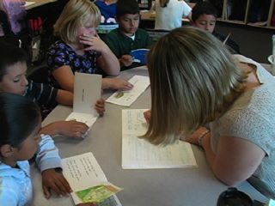
What teachers do:
Assess readers three times a year to confirm reading level and learn what specific skills are needed.
Read with similarly-abled students in small groups to address needs.
Make sure students read just-right
books and focus on comprehension.

Slide 9
Decoding
Get your mouth ready for the first sound/ first consonants/blend/digraph
Use the picture (meaning)
Check- does it match what you said?
Pull in another letter/vowel
Flip the vowel
Check- does it match what you said?
Chunk the word.
Is there a part you know?
Check- does it match what you said?

Slide 10
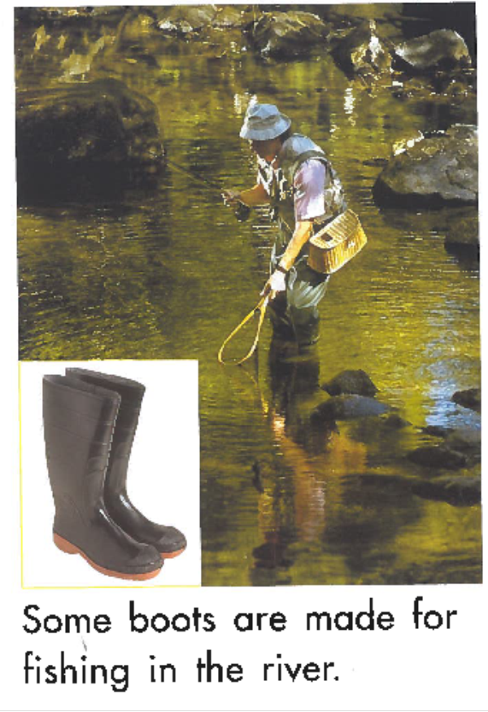

Slide 11
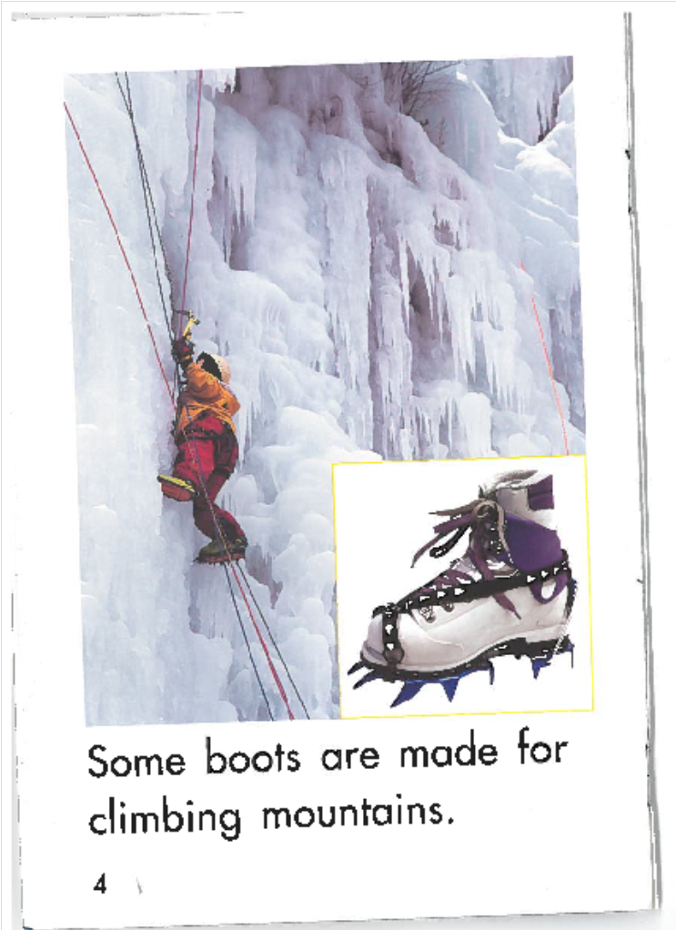

Slide 12
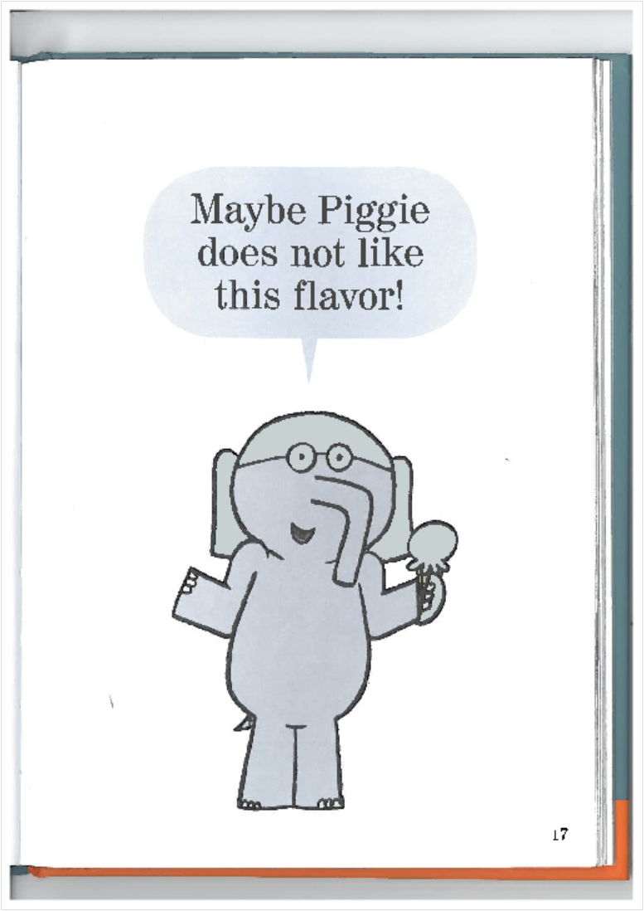

Slide 13
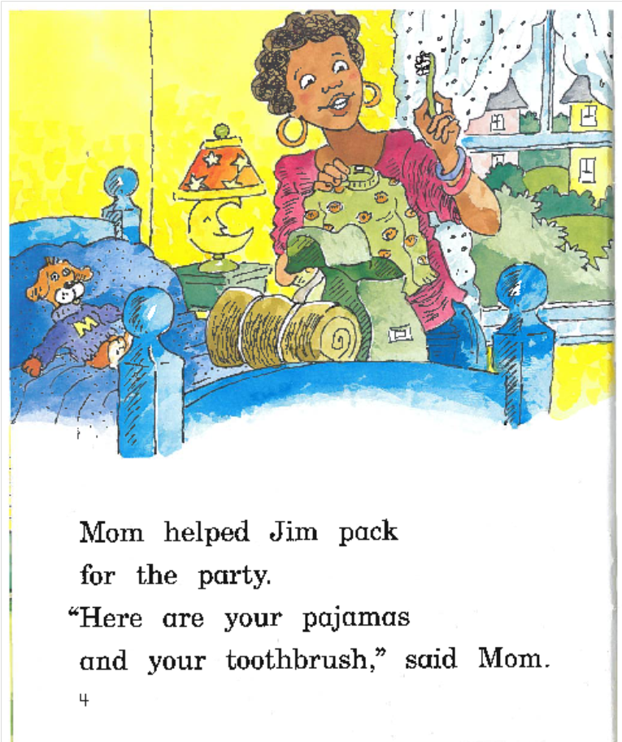

Slide 14
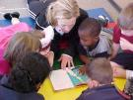
What to say instead of correcting or over-assisting:
You’re using the picture—
how smart of you!
Does that sound right? (don’t jump in to correct!)
That sounds right, doesn’t it?
Does that make sense?
That makes sense, doesn’t it?
Do the letters match the word you said?

Slide 15
Practice Sight Words Regularly
Automaticity
Confidence
January Benchmarks K= 12-18 Grade 1= 75-90
Make it Fun! Memory, Bingo, Go Fish
              Apps
              Trace, write in shaving cream, on carpet

Slide 16

Comprehension-
Model Getting Ready to Read
At the beginning of a book:
Look at the cover and read the book jacket summary. Tell your child what you think the book’s going to be about.
Figure out who’s telling the story (narrator) and where and when it takes place. (setting)
Identify the main characters.

Slide 17
Model Word Work
If you come to a big word, slow down and show your child how you sound it out. croc-o-dile chrys-an-the-mum
If you come to an interesting word, stop and talk about its meaning. Show your child how to use clues from the sentences and pictures.
Jack outwitted the giant. Sylvester was weary…
Use the new words you “learned” together.

Slide 18
Model the thinking readers do
Talk about what the words are making you picture in your mind .
Talk about what the words are making you feel.
Tell your child when you’re surprised, confused, wondering something, predicting something will happen…
Compare the book to others you’ve read.
Encourage your child to share his thinking with you.

Slide 19
Build vocabulary & background knowledge
Read nonfiction picture books.
Watch educational television.
Visit museums and historic sites.
Subscribe to an informational magazine.
Talk about what you observe and learn.

Slide 20
The Developmental Nature of Reading
Readers develop at different rates.
Concepts “click in” at different times for different children.
Comparisons among children are not productive.
There will be bursts of growth and times where growth levels off.
All reading instruction is differentiated.
Teachers provide interventions in a variety of ways.
Parental input is valued.

Slide 21
Essential ideas:
It is possible for young readers to read smoothly, quickly, and not comprehend a word. Focus on meaning.
Reading should be pleasurable. People choose activities that make them feel good. Value joke book, magazines, comic books…(choice!)
Daily practice is essential for the development of any skill.
Readers need to feel competent. Show your child you’re confident in his/her ability. Marvel at his/her EFFORT and thinking!
Children need parents who limit screen time.
It is important to SLOW DOWN and make time for what’s important.

Slide 22
Goals for parents:
Read to your children.
Be a reading role model.
Honor and encourage EFFORT over achievement.
Help build vocabulary and background knowledge.
Communicate with your child’s teacher.
Attend workshops and school events!

